Slide 1
Advanced Pentaho Data Integration
James O’Reilly

Slide 2
Agenda
Metadata Injection
PDI as a Data Source
Data Streaming
Scalability
Project Management

Slide 3
Pentaho Data Integration Scaling your Enterprise Solution
James O’Reilly

Slide 4
Agenda
Carte Clusters
Stream Partitioning
PAN & KITCHEN command lines
Scheduling
Checkpoints & Transactional Transformations

Slide 5
Carte Clusters

Slide 6
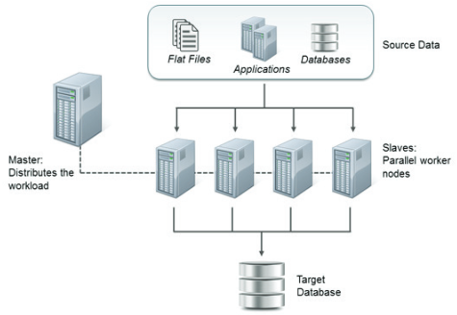
Clustering Carte Servers
Clustering is a technique that can be used to scale out transformations to make them run on multiple servers, in parallel.
The Cluster is defined with a Schema, with one master server acting as the controller for the cluster.
The Cluster schema also contains metadata on how master and slaves pass data back and forth.

Slide 7
Clustering Carte Servers
Master DI server
Default configuration for low volume and process mix
Master DI server with Independent number Carte servers
Used for large amount of transformations of lesser volume
Master acts as a load balancer for transformations

Slide 8
Clustering Carte Servers
Master DI server with slave servers (Clustering)
Used for large volumes with fewer transformations
Distributes set of rows across slave servers
Can be fixed cluster size or dynamic

Slide 9
Carte Server
Carte is a lightweight HTTP server that accepts commands from remote clients.
These commands control the deployment, management, and monitoring of Jobs and Transformations.
The Carte server can be started in a number of ways, but essentially you require IP-address / hostname and port
sh carte.sh localhost 8000
carte.bat localhost 8000

Slide 10
Carte Clusters
A cluster schema is essentially a collection of slave servers.
Static Carte cluster has a fixed schema that specifies one master node and two or more slave nodes. In a static cluster, you specify the nodes in a cluster at design-time, before you run the transformation or job.
A Dynamic Carte cluster has a schema that specifies one master node and a varying number of slave nodes. Unlike a static cluster, slave nodes are not known until runtime. Instead, you register the slave nodes, then at runtime, PDI monitors the slave nodes every 30 seconds to see if it is available to perform transformation and job processing tasks.

Slide 11
Guided Demonstration: Master & Slave Servers
Configure Master and 2 Slave Servers
Its best practice to define a carte instance with an XML file. Examples can be found at:
C:\Pentaho\design-tools\data-integration\pwd
Copy over the carte-config-11100.xml to
C:\Pentaho\design-tools\data-integration
 | MASTER NODE | SLAVE NODE 1 | SLAVE NODE 2
Server IP | localhost | localhost | localhost
Port Number | 11000 | 11100 | 11110
Master / Slave | Master | Slave1 | Slave2

Slide 12
Guided Demonstration: Carte Security
The default credentials to log into a Carte Cluster:
Username: cluster
Password: cluster
This can obfuscated using encr command:
Encr –carte Pentaho2018
OBF:1g2f1iur1kfx1m0x1u9d1u9r1ua51lx91kch1irv1g13
Copy to kettle.pwd

Slide 13
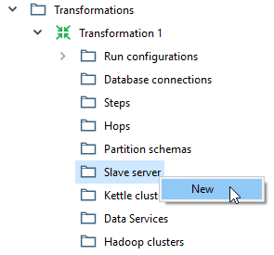
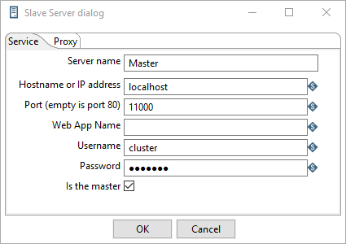
Guided Demonstration: Master & Slave Servers
Define Carte Servers in Spoon

Slide 14
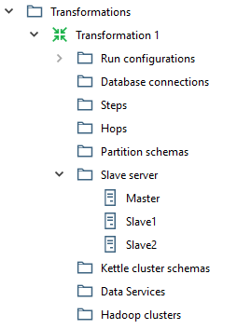
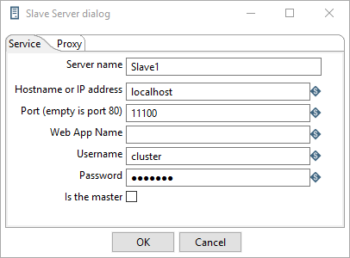
Guided Demonstration: Master & Slave Servers
Define Carte Servers in Spoon

Slide 15
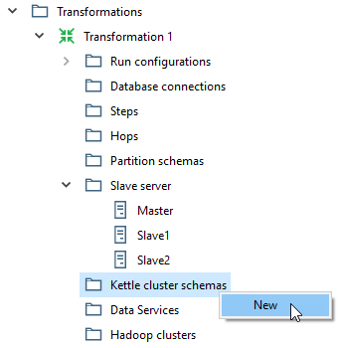
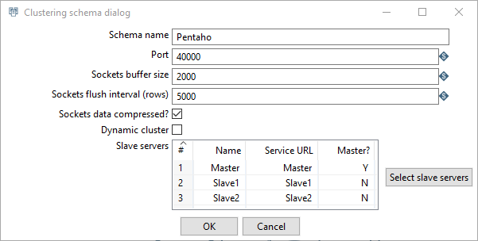
Guided Demonstration: Schema
Define a Schema in Spoon

Slide 16
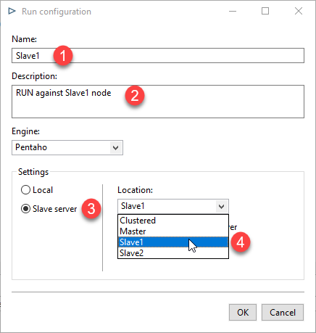

Guided Demonstration: Transformation
Define Transformation
Define different RUN Configurations..
Check the Carte Server command window.

Slide 17

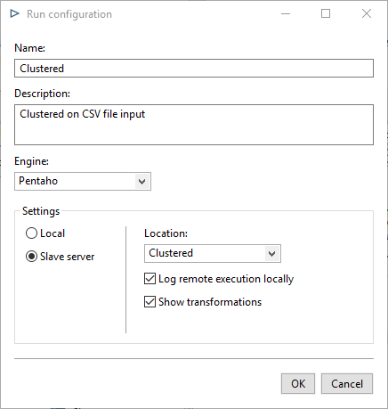
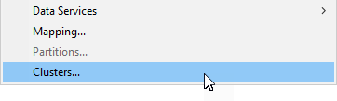
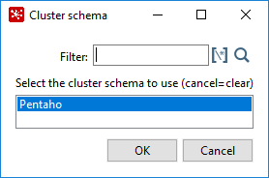
Guided Demonstration: Clustered
Configure to RUN on a Cluster

Slide 18
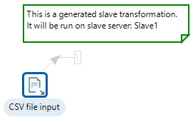
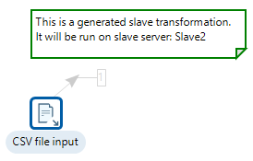
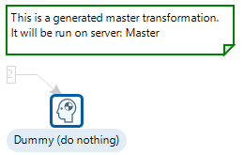
Guided Demonstration: Clustered
When running transformations in a clustered environment, you have option to Show transformations, which displays the generated (converted) transformations that will be executed on the cluster.

Slide 19
Guided Demonstration: Monitor
Web Browser
Open a browser window and type in the address of the slave server.
Master: http://localhost:11000/kettle/status
Slave1: http://localhost:11100/kettle/status
Slave2: http://localhost:11110/kettle/status
You will need to enter the login credentials:
Username: cluster
Password: cluster

Slide 20
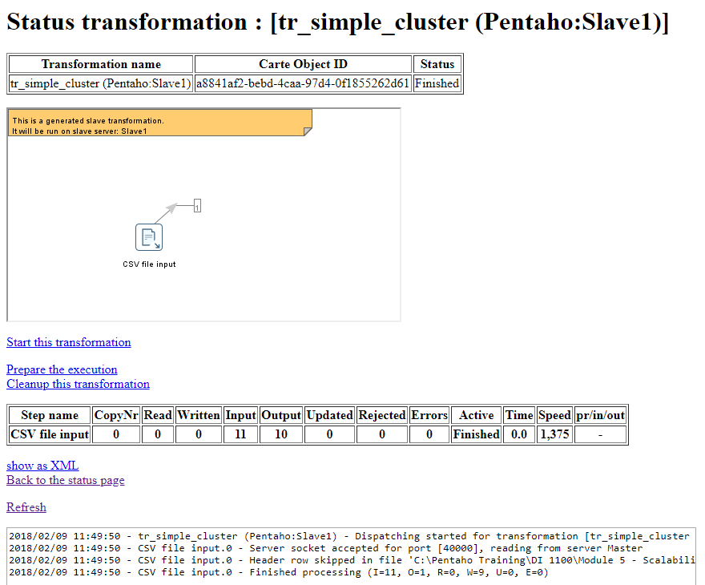
Guided Demonstration: Monitor

Slide 21
Round Robin or Copy?

Slide 22
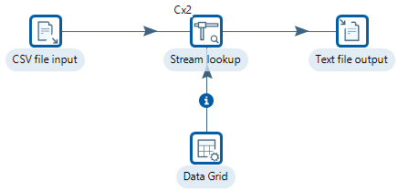
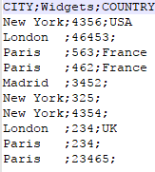
Guided Demonstration: Round Robin or Copy?
There is a common pitfall when designing clustered transformations. A step on the Master that needs to stream rows to steps on cluster slaves will distribute the rows among all cluster slaves in a Round-Robin fashion.

Slide 23
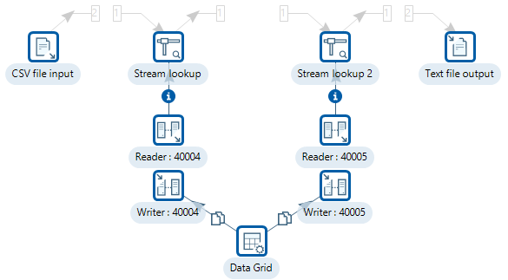
Guided Demonstration: Round Robin or Copy?
The problem is data movement is round-robin
Switch the Data Grid to Copy

Slide 24
Group By

Slide 25

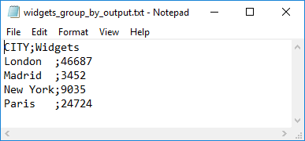
Guided Demonstration: Group By
Modify the tr_cluster_demo to include group by
RUN against LOCAL

Slide 26
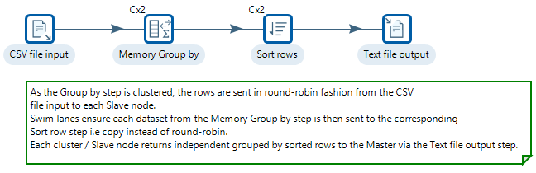
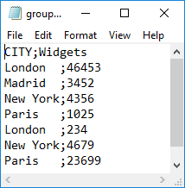
Guided Demonstration: Group By
If a Group by / Sorted output is required, then its recommended to scale-out the Group by / Sorting operations to the cluster slaves.

Slide 27
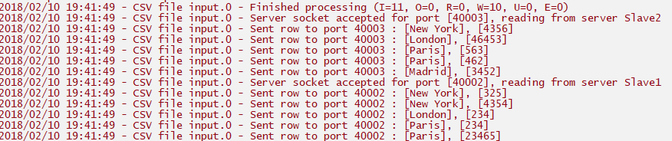
Guided Demonstration: Group By
Clue is in the Logs
Master

Slide 28
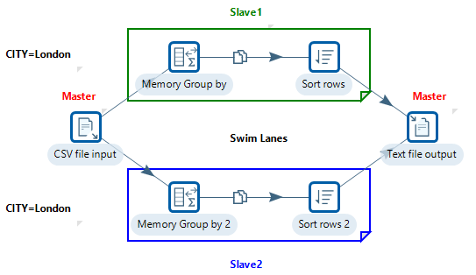
Guided Demonstration: Group By
As the Memory Group by and Sort rows steps have been configured for clustering; swim lanes are enforced. Each Memory Group by instance will stream its own copy of the rows to the same copy of the Sort rows step.

Slide 29
Stream Partitioning

Slide 30
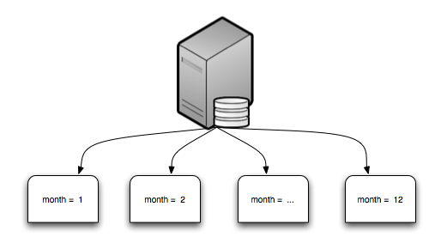
Stream Partitioning
Partitioning is done to enhance performance and facilitate easy management of data.
Partitioning clickstream data
by month

Slide 31
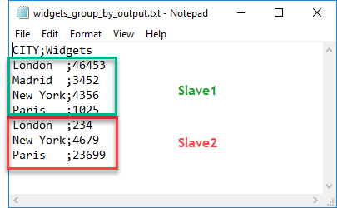
Stream Partitioning
If you remember in our preceding Transformation, tr_clustered_group_by.ktr, the challenge was ensure that data for a particular City goes to one slave server, where the sorting and aggregation occurs, and city to another slave server, and so on.. in other words, the data is partitioned per a key value.

Slide 32
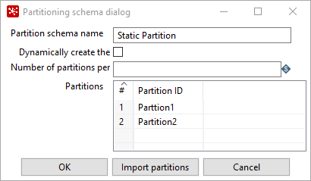
Guided Demonstration: Partition Schema
Partitioning simply splits a data set into several sub-sets per a rule that is applied on a row of data.

Slide 33
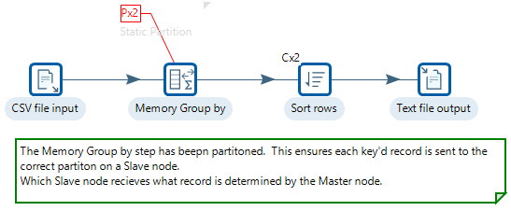
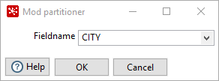
Guided Demonstration: Partition Schema
Apply the Partition to the Group by step

Slide 34
PAN & KITCHEN Command Line

Slide 35
PAN & KITCHEN Command Line
You can use PDI's command line tools to execute PDI content from outside of Spoon.
Kitchen.bat / file : <path to ktr> - run Pan on the Windows platform.
Kitchen.sh - file : <path to ktr> - run Pan on Unix platforms and OSX
Pan.bat / file : <path to ktr> - run Pan on the Windows platform.
Pan.sh - file : <path to ktr> - run Pan on Unix platforms and OSX

Slide 36
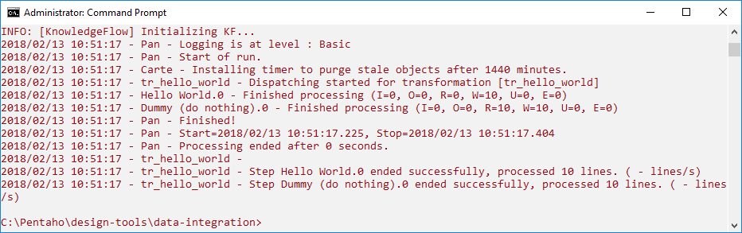
Guided Demonstration:
Open a CMD window with Admin rights.
Change Directory to:
C:\Pentaho\design-tools\data-integration>
Enter the following:
Pan.bat /file:C:\Projects\transformations\tr_hello_world.ktr /level:Basic

Slide 37
Scheduling

Slide 38
Scheduler
Windows Task Scheduler
Jenkins

Slide 39
Windows Task Scheduler

Slide 40
Windows Task Scheduler
You can use the schtasks command to schedule a command, a script, or a program to run at a specified date and time. You can also use this command to view existing scheduled tasks.
Syntax
schtasks /create /tn TaskName /tr TaskRun /sc schedule [/mo modifier] [/d day] [/m month[,month...] [/i IdleTime] [/st StartTime] [/sd StartDate] [/ed EndDate] [/s computer [/u [domain\]user /p password]] [/ru {[Domain\]User | "System"} [/rp Password]] /?

Slide 41
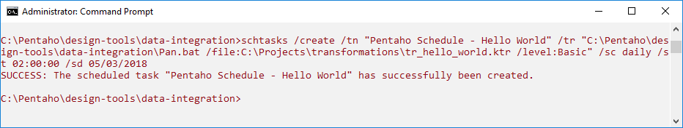
Guided Demonstration: Task Scheduler
Open a CMD window with Admin rights
Type the following:
schtasks /create /tn "Pentaho Schedule – Hello World" /tr "C:\Pentaho\design-tools\data-integration\Pan.bat /file:C:\Projects\transformations\tr_hello_world.ktr /level:Basic" /sc daily /st 02:00:00 /sd 01/04/2018

Slide 42
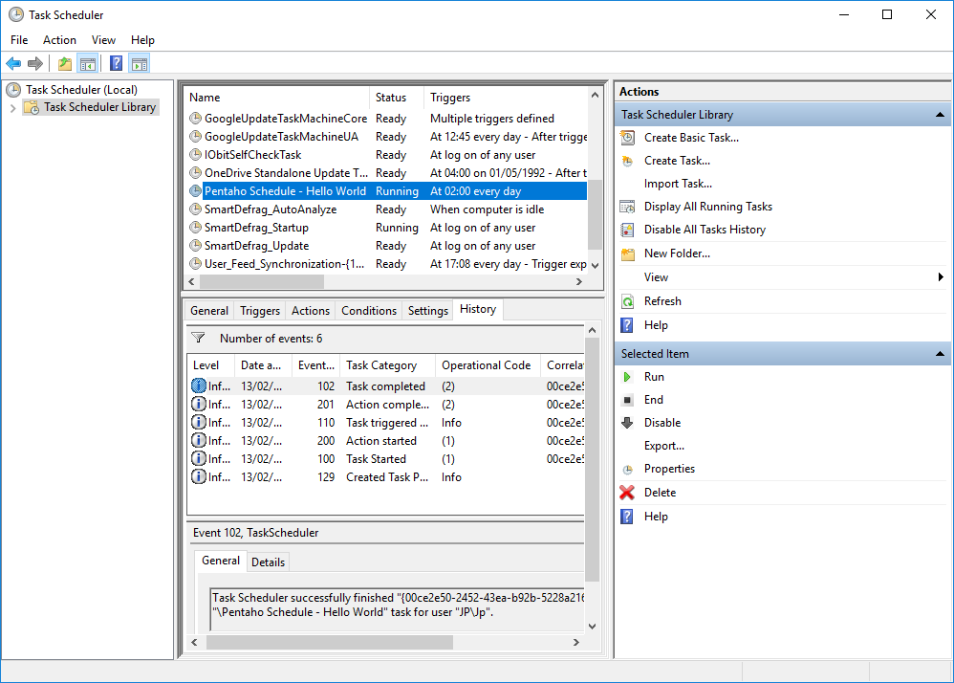
Guided Demonstration: Task Scheduler
You could schedule a batch file (.bat) that contains all the transformations that need to be run at a specific time.

Slide 43
Jenkins

Slide 44
Jenkins
Jenkins is a self-contained, open source automation server which can be used to automate all sorts of tasks such as building, testing, and deploying source code.
Jenkins has many plugins that allow you to extend its functionality, for example; the Git plugin can easily pull source code from any Git repository that the Jenkins build node can access.
The official website for Jenkins: https://jenkins-ci.org/

Slide 45
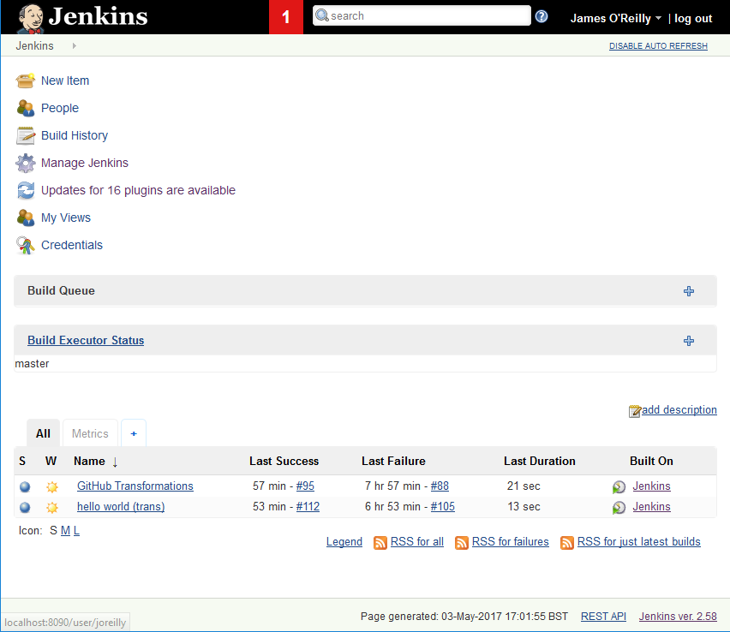
Jenkins
Jenkins: http://localhost:9000
Username: Pentaho
Password: password

Slide 46
Checkpoints

Slide 47
Checkpoints
Checkpoints let you restart jobs that fail without you having to rerun the entire job from the beginning. You add checkpoints at hops that connect one job entry to another.
Then, when you run the job and a checkpoint is encountered, the software saves the state of the job entry, including the parameters, internal result rows, and result files.
If an error occurs that causes the job to fail, like the database is not functioning properly so you can't connect to it, the job ends.

Slide 48

Checkpoints
Every job entry in a job can become a checkpoint. You can simply right click on the job entry and enable the "checkpoint" option.

Slide 49
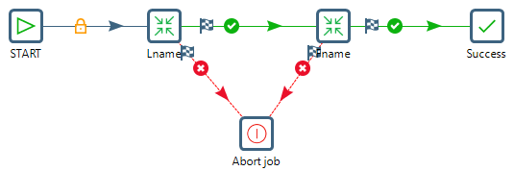
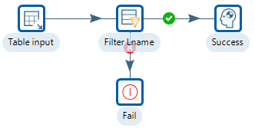
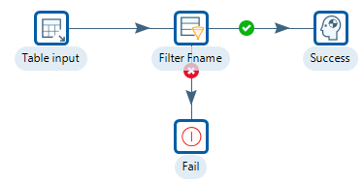
Guided Demonstration: Checkpoints
Open jb_checkpoints.kjb
Ensure they are saved in the Pentaho Repository

Slide 50
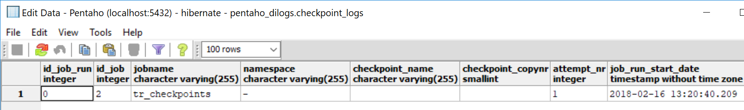
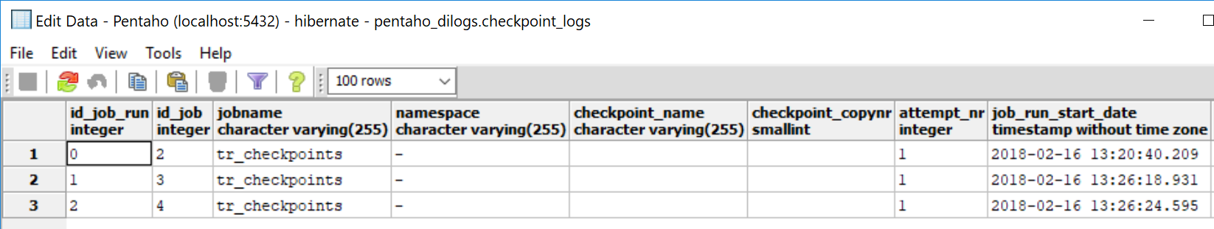
Guided Demonstration: Checkpoints
Scenario 1 - Normal
RUN jb_checkpoints.kjb
RUN again

Slide 51
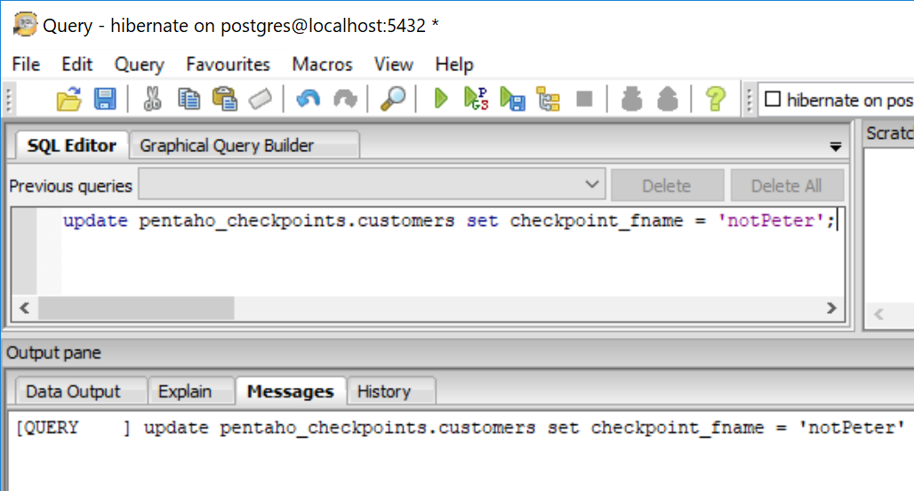
Guided Demonstration: Checkpoints
Scenario 2 - Fail on Fname (max attempts_nr)
In your SQL editor execute the following statement:
update pentaho_checkpoints.customers set checkpoint_fname = 'notPeter';

Slide 52
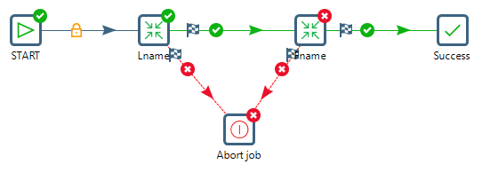
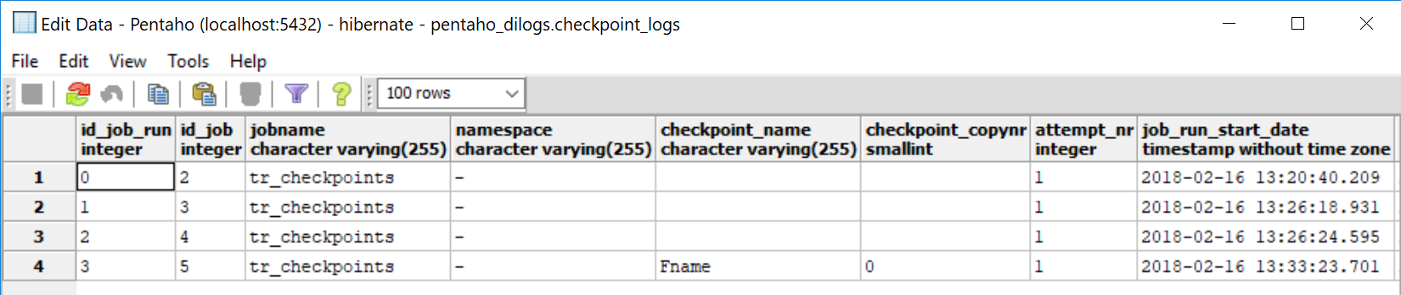
Guided Demonstration: Checkpoints
RUN tr_checkpoints.kjb.
Check the Logging status

Slide 53
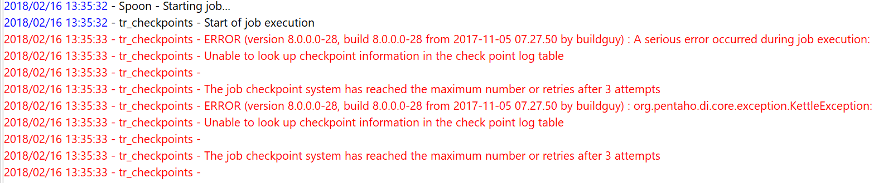
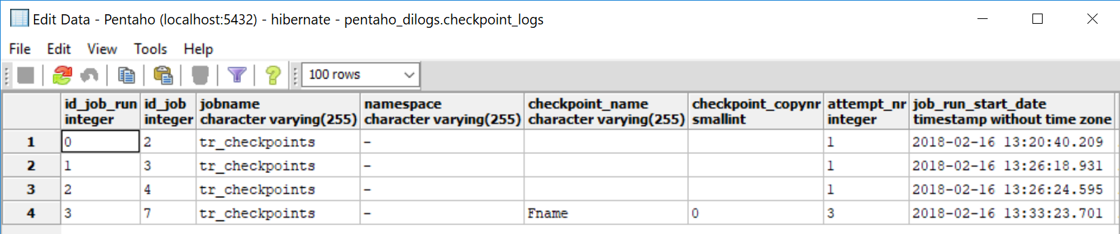
Guided Demonstration: Checkpoints
Run the tr_checkpoints.kjb another 3 times and examine the logging info.
The Job is now ‘disabled’ and will not RUN until the checkpoint table is reset.

Slide 54
Guided Demonstration: Checkpoints
Scenario 3 - Reset on Fname
In your SQL editor execute the following statement:
delete from pentaho_dilogs.checkpoint_logs
where id_job_run='X';
Enter the id_job_run number
Check the checkpoint_logs table that the record has been removed.

Slide 55
Guided Demonstration: Checkpoints
In your SQL editor execute the following statement:
update pentaho_checkpoints.customers set checkpoint_fname = 'Peter';
RUN the tr_checkpoints.kjb several times. The issue has now been resolved, so new records will be entered in the Checkpoints table.

Slide 56
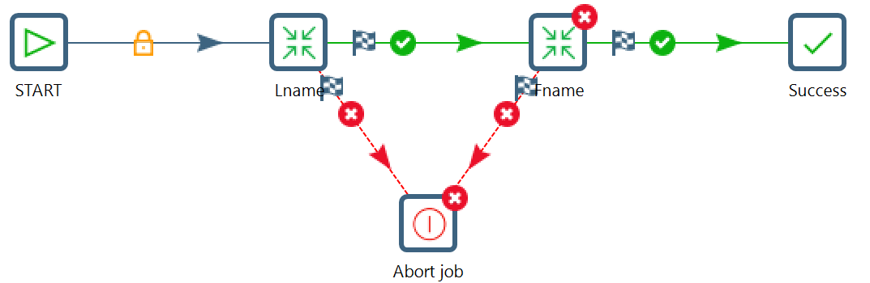
Guided Demonstration: Checkpoints
So now let’s cause the Job to fail on Fname, reset before the max number of attempts and reRUN the Job.
In your SQL editor execute the following statement:
update pentaho_checkpoints.customers set checkpoint_fname = 'notPeter';
Just RUN 2 times. Notice the second time you RUN the Job it starts from the Fname step.

Slide 57
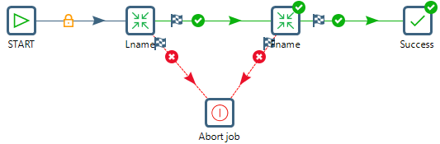
Guided Demonstration: Checkpoints
In your SQL editor execute the following statement:
update pentaho_checkpoints.customers set checkpoint_fname = 'Peter';
As the Job has RUN once, and as the Lname step has already been successfully executed, the Job starts from the Fname Transformation.

Slide 58
Transactional Transformations

Slide 59
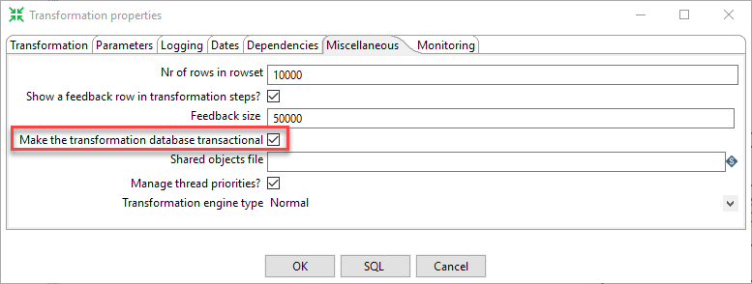
Transactional Transformations
When running a transformation, it is sometimes useful to have the results rollback on an error.
If your database system supports transactions, then enable “Make transformation database transactional” checkbox on the “Miscellaneous” tab in the transformation settings dialog.

Slide 60
Transactional Transformations
The transformation reads records from a table, transforms some fields, and updates the records in the original table.
This usually is carried out with a table input step, some transforming steps, and an update step.
Both the table input and the update step would use the same database definition “MyData”. When the transformation is RUN, each of the steps maintains its own connection to the “MyData” database.

Slide 61
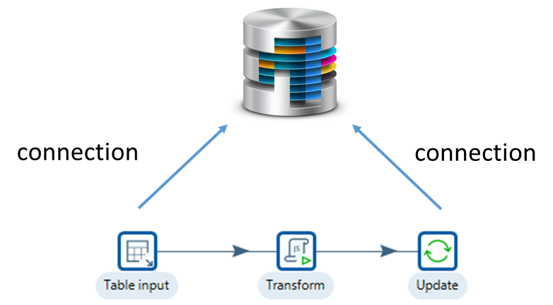
Transactional Transformations
The transformation steps have separately defined database connections

Slide 62
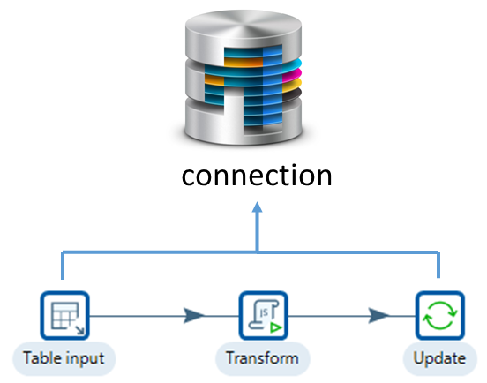
Transactional Transformations
Every connection begins a transaction when it is opened. The transaction is committed if the transformation completes successfully; and rolled back if the transformation encounters an error or ended prematurely.

Slide 63
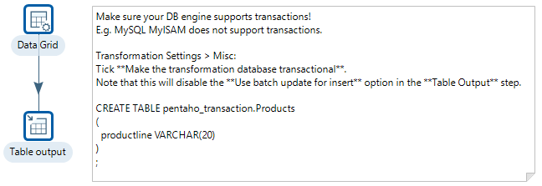
Guided Demonstration: Transactional
Enable Transactional

Slide 64
Summary
Carte Clusters
Stream Partitioning
PAN & KITCHEN command lines
Scheduling
Checkpoints & Transactional Transformations

Slide 65
Thank You

